Slide 1
CSE1142 –Repetitive Structures in C
Sanem Arslan Yılmaz
Some of the slides are from:
CMPE150 – Boğaziçi University
Deitel & Associates

Slide 2
Agenda
Types of loops
For loop
  Syntax
  Example
While loop
  Syntax
  Example
Do-while loop
  Syntax
  Example
Break statement
Continue statement

Slide 3
Types of loops
There are three types of loops:
  "for" loop
  "while" loop
  "do-while" loop
You can implement anyone of these loops using the others (and possibly an additional if statement and duplication of some statements).
  The idea is to use the type of loop that is best suited for your problem.

Slide 4
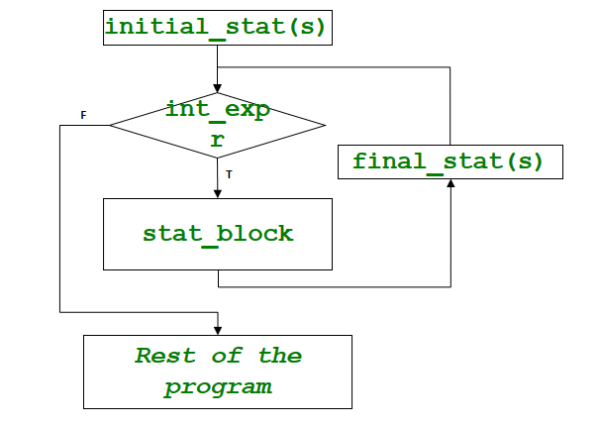
For loop syntax
Syntax:
    for (initial_stat(s); int_expr; final_stat(s))
    stat_block

Slide 5
For loop
Note that initial and final statements as well as the integer expression are optional according to the syntax.
  If initial_stat(s) is missing, start directly with the comparison.
  If final_stat(s) is missing, go directly to the comparison after the execution of the statement block.
  If int_expr is missing, the comparison is always true.
    Make use of the break statement.

Slide 6
For loop – Example I
Print all numbers between 1-10
int main(void)
{
unsigned int counter;
// initialization, iteration condition, and increment
// are all included in the for statement header.
for (counter = 1; counter <= 10; ++counter) {
printf("%u\n", counter);
}
}

Slide 7
For loop – Example II
Find the sum of all even numbers between 2-100
int main(void)
{
unsigned int sum = 0, number; // initialize
for (number = 2; number <= 100; number += 2) {
sum += number; // add number to sum
}
printf("Sum is %u\n", sum);
}

Slide 8
For loop – Example III
Find a^{b}. (a and b integers)
int a, b, result=1, i;
scanf("%d %d", &a, &b);
for (i=0; i<b; i++)
result *= a;

Slide 9
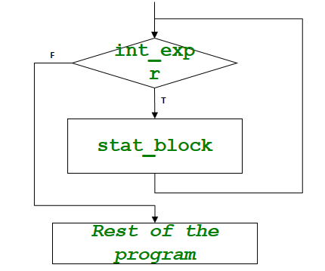
While loop syntax
Use while loop if the statement block should be executed as long as a condition holds.
Syntax:
    while (int_expr)
    stat_block

Slide 10
While loop – Example I
Print all numbers between 1-10
int main(void)
{
unsigned int counter = 1; // initialization
while (counter <= 10) { // iteration condition
printf ("%u\n", counter);
++counter; // increment
}
}

Slide 11
While loop – Example II
Find the average of a sequence of integers terminated with a negative value.
int sum=0, n, count=0;
float avg;
scanf("%d", &n);
while (n>=0)
{
sum += n;
count++;
scanf("%d", &n);
}
avg = (count)?(float)sum/count:0;

Slide 12
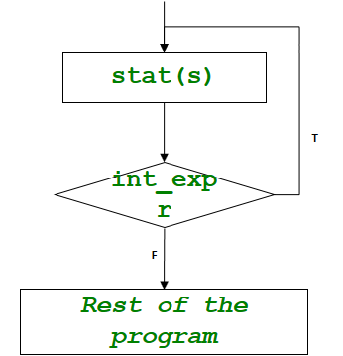
Do-while loop syntax
Similar to while loop.
  Only difference: Condition is checked after the execution of every iteration.
Syntax:
    do
    {
    stat(s)
    }
    while (int_expr);

Slide 13
Do-while loop – Example I
Print all numbers between 1-10
int main(void)
{
unsigned int counter = 1;
do {
printf("%u\n", counter);
} while (++counter <= 10);
}

Slide 14
Break statement
It is possible to terminate a loop prematurely.
Remember the break statement we discussed before.
  break breaks the innermost loop or switch statement.

Slide 15
Break - Example
Break when number is equal to 5
int main(void){
unsigned int x; // declared here so it can be used after loop
// loop 10 times
for (x = 1; x <= 10; ++x) {
// if x is 5, terminate loop
if (x == 5) {
break; // break loop only if x is 5
}
printf("%u\n", x);
}
printf("\nBroke out of loop at x == %u\n", x);
}

Slide 16
Continue statement
It is possible to skip the rest of an iteration and continue with the next iteration (if any).
  In the for loop, continue jumps to the final statement.
  In the while and do-while loops, continue jumps to the condition expression.

Slide 17
Continue - Example
Continue when number is equal to 5
int main(void){
unsigned int x;
// loop 10 times
for (x = 1; x <= 10; ++x) {
// if x is 5, continue with next iteration of loop
if (x == 5) {
continue; // skip remaining code in loop body
}
printf("%u\n", x); // display value of x
}
printf("\nUsed continue to skip printing the value 5");
}

Slide 18
Example - 1
Read an integer and print its digits in reverse order.
  #include <stdio.h>
  int main()
  { int num, digit;
  scanf("%d",&num);
  while (num)
  { digit=num%10;
  num /= 10;
  printf("%d", digit);
  }
  return 0;
  }

Slide 19
Example - 2
Draw a square or rectangle. Take length and width as input.
int main(void){
unsigned int x, y, i, j;
// prompt user for input
printf("Enter two unsigned integers in the range 1-20: ");
scanf("%u%u", &x, &y); // read values for x and y
for (i = 1; i <= y; ++i) { // count from 1 to y
for (j = 1; j <= x; ++j) { // count from 1 to x
printf("*");
}
printf("\n");
}
}

Slide 20
Example - 3
Draw a triangle. Take length as input.
int main(void){
unsigned int x, i, j;
// prompt user for input
printf("Enter length: ");
scanf("%u", &x); // read value for x
for (i = 1; i <= x; i++) { // count from 1 to x
for (j = i; j <= x; j++) { // count from i to x
printf("*");
}
printf("\n");
}
}

